Slide 1
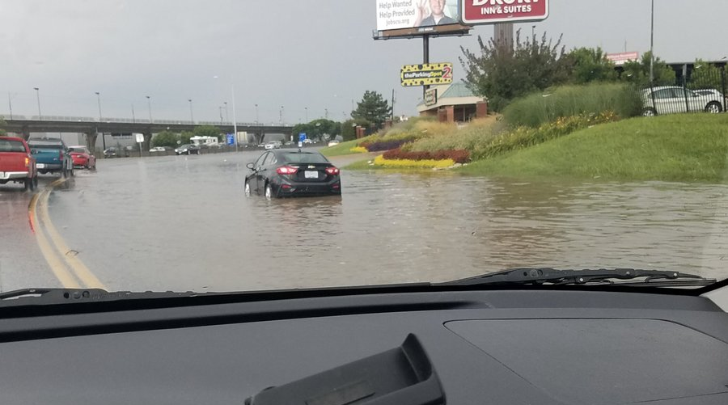
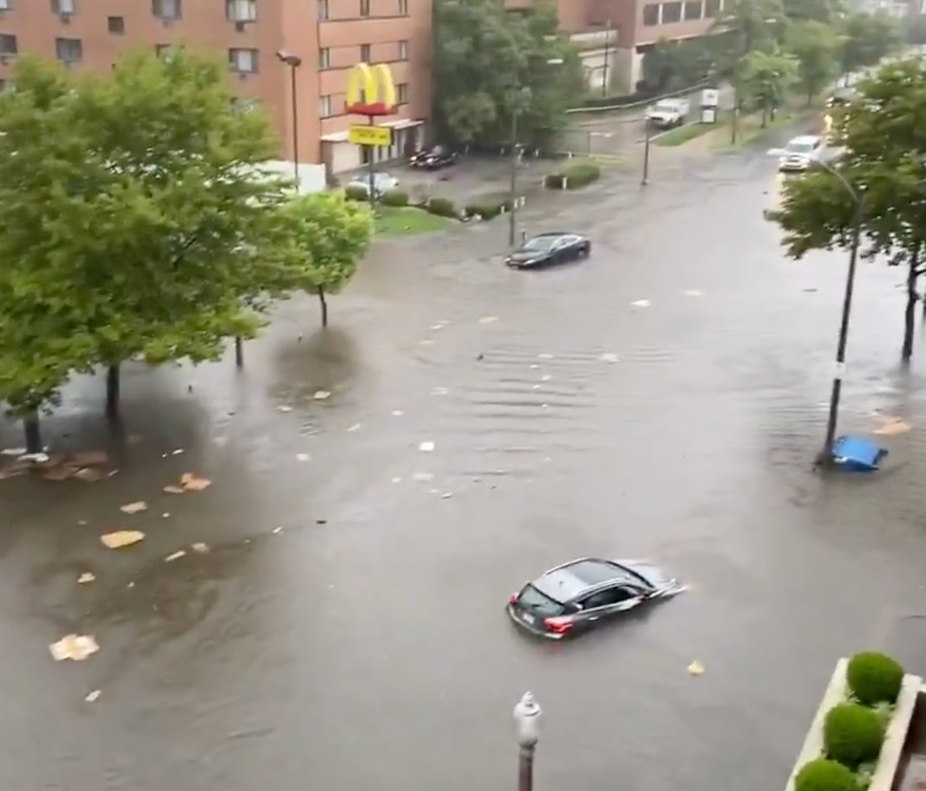
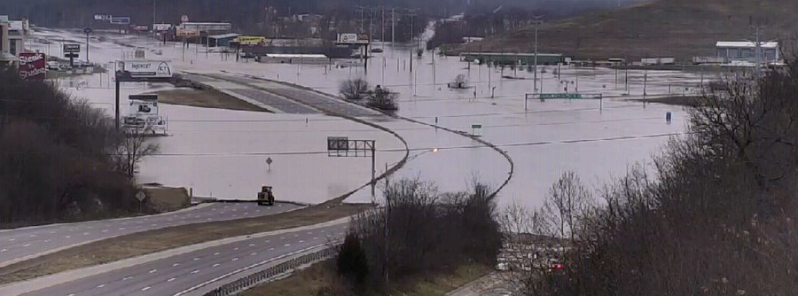
How can we quickly identify flooded streets and pass across information to residents? Will Mobley Institute for Disaster Resilient Texas Texas A&M Galveston
Notes:
This can cause disruptions such as
limited mobility
Loss of Services
………..etc

